Slide 1

NBA Finals Playoff Bracket
Brian Brungardt
Liam Crawley
Nathan Fraser
Jack Hill
Christopher Hyland
Taylor Neal
Andy Wang

Slide 2
Purpose
A model is being created to generate a predicted winner along with a complete bracket prediction for the 2022 NBA Finals.
A Monte Carlo simulation is also performed with an iteration of 1000 times to predict how many games out of 1000 times a team will win the tournament.

Slide 3
Methods
We are using public data from sportsreference.com by aggregating the data into a database using SQL and GCP.
A probit model is then constructed and trained on the newly created database, forming winning probabilities for each matchup of teams.
A probit model is used because score differentials tend to follow a normal distribution pattern, giving us the best chance of having accurate predictions.

Slide 4
Regression fitting
We used Lasso in R to fit a regression over the regular season stats.
The Lasso method allowed us to penalized the addition of each variable , which helped us prevent overfitting.
This method was preferred over random forest due to its resistance to overfitting.

Slide 5
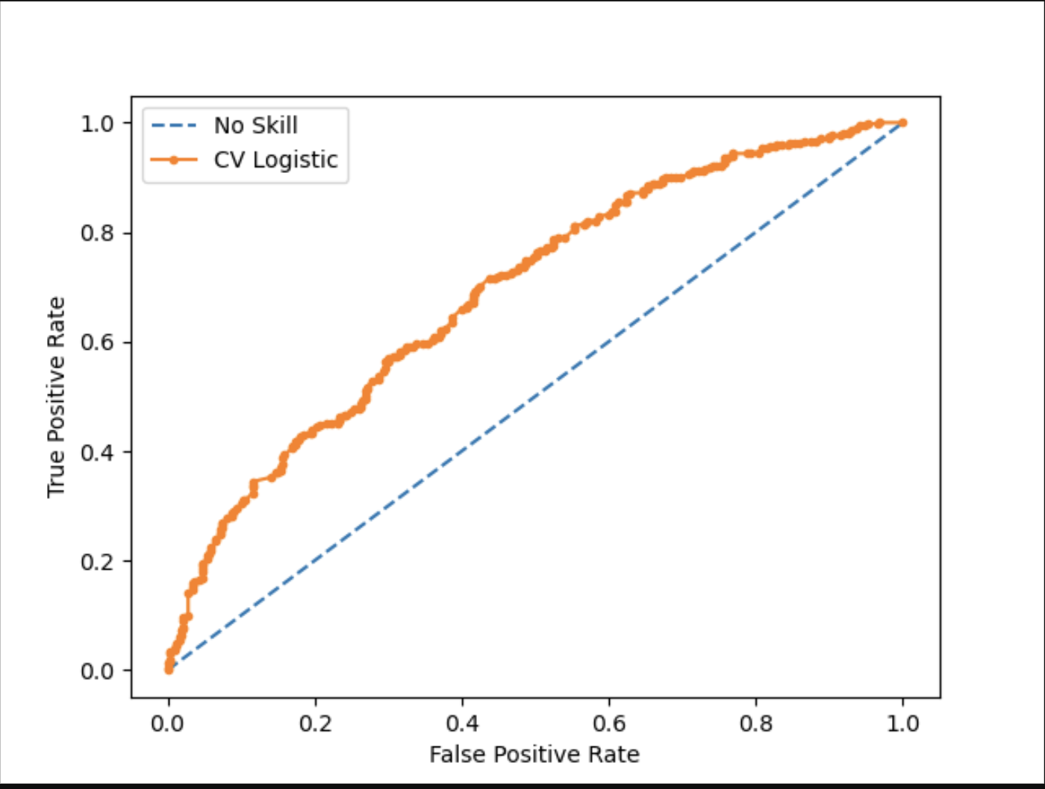
The increased True Positive Rate of the CV logistic regression at given false positive rates indicates that our machine learning made our regression substantially better than guessing

Slide 6
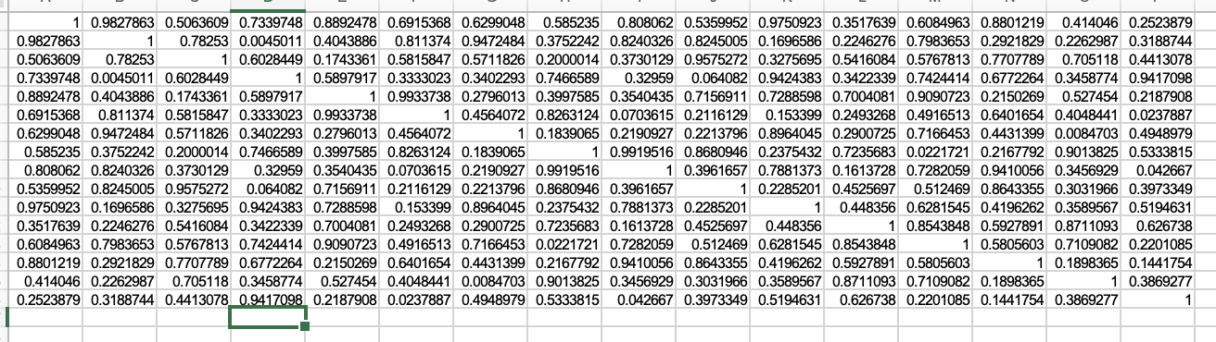
Matrix of Win Probabilities
By predicting a matrix of win probabilities, we can use random draws values to determine winners in a simulated bracket. By repeating this process through a Monte Carlo simulation, we can calculate a winning percentage for each team by dividing their total championship wins over the total iterations of the Monte Carlo simulation

Slide 7
Monte Carlo to Bracket
By recording the iterated steps of our Monte Carlo simulation, we are able to create and visualize specific brackets

Slide 8
Future Exploration
We can utilize in-game statistics for specific players to determine their likely scoring performance, most likely in a range of 95% likely-hood.
We would use feature engineering to decipher the strongest predictors of scoring performance, and use those in a model to predict any given player’s scoring statistics in a mock final.
For example, we may predict that if Golden State Warriors win the final, Steph Curry is likely to score between 27 and 34 points

